Slide 1
Presentation 4
Phase I: Machine Learning
Alireza Toghyiani - 17/02/2022

Slide 2
Feature Selection
Mutual information
Find any relations between our features and the target
Recursive Feature Elimination (RFE)
Recursive Feature Elimination or RFE is a Feature Selection method utilizing a machine learning model to selecting the features by eliminating the least important feature after recursively training
Feature Selection via SelectFromModel
Like the RFE, SelectFromModel from Scikit-Learn is based on a Machine Learning Model estimation for selecting the features. The differences are that SelectFromModel feature selection is based on the importance attribute threshold (default threshold is the mean)

Slide 3
Overfitting Problem in VAE
I had a problem in my vae model, the validation loss was constant in every epochs
According to my research it seems that my model was overfitting and this was a sign of this problem
I had 2 ideas to fix it:
I was mixing the train and test data and then run Scaling on the data
I put number of epochs randomly on 20 and it may causing the overfitting problem by running more than required epochs

Slide 4
Early Stopping
A problem with training neural networks is in the choice of the number of training epochs to use
Too many epochs can lead to overfitting of the training dataset, whereas too few may result in an underfit model
Early stopping is a method that allows you to specify an arbitrary large number of training epochs and stop training once the model performance stops improving on a hold out validation dataset.
Set monitor in Keras model and by specifying the performance measure to monitor and stop the training

Slide 5
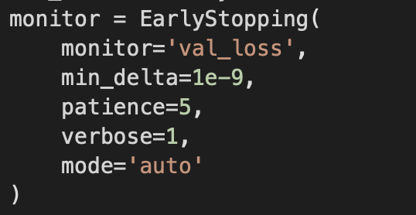
Early Stopping
The “monitor” allows us to specify the performance measure to monitor in order to end training
To discover the training epoch on which training was stopped, the “verbose” argument can be set to 1
Often, the first sign of no further improvement may not be the best time to stop training. This is because the model may coast into a plateau of no improvement or even get slightly worse before getting much better, This can be done by setting the “patience” argument
Min delta is the amount of changes in performance measure that will considered an improvement

Slide 6
Feature Seletion
With [id_orig_p, id_resp_p, missed_bytes, orig_pkts, orig_ip_bytes, resp_pkts, resp_ip_bytes]
accuracy = 0.9

Slide 7
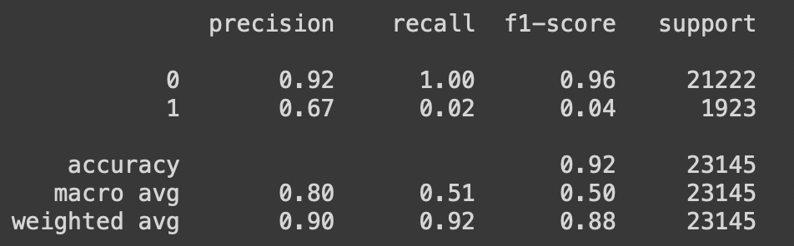
Feature Seletion
With [id_orig_p, id_resp_p, orig_pkts, orig_ip_bytes, resp_pkts, resp_ip_bytes]
accuracy = 0.92

Slide 8
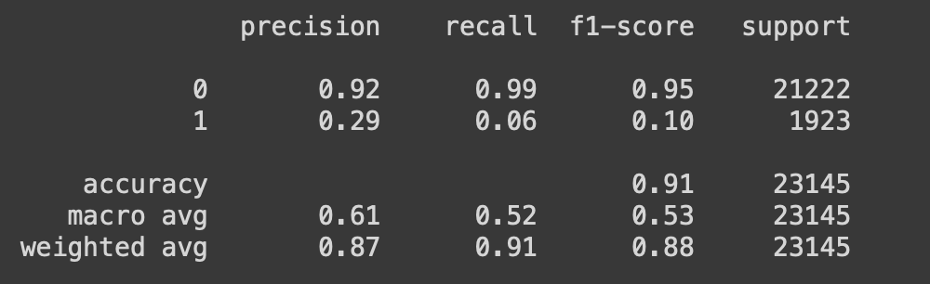
Feature Seletion
With [id_orig_p, id_resp_p, orig_pkts, orig_ip_bytes, resp_ip_bytes]
accuracy = 0.91

Slide 9
Different Problems
Supervised
Classification
Product grading
Object detection
Regression: A regression problem is when the output variable is a real/continuous value, such as “salary” or “weight” such as:
House Price Prediction
Ride/Shipment Price Prediction

Slide 10
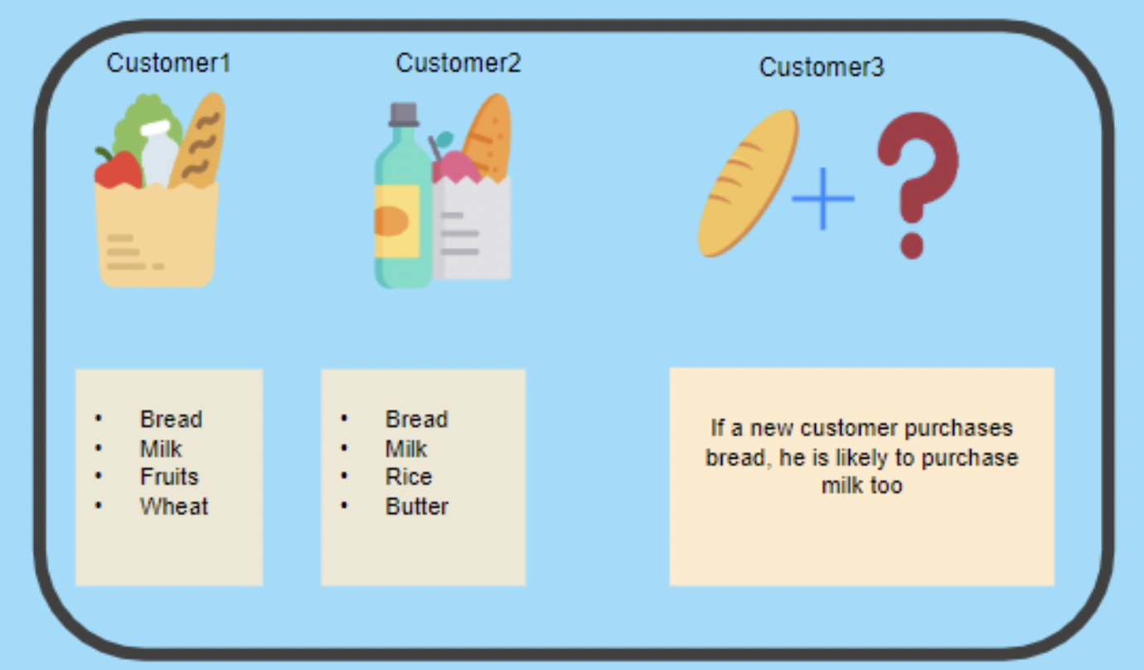
Different Problems
Unsupervised
Clustering: Group similar data records together such as:
Recommendation Engines
Anomaly Detection
Association: Learn by observing the co-occurrence of objects together
Credit: https://.simplilearn.com/tutorials/machine-learning-tutorial/supervised-and-unsupervised-learning

Slide 11
Accuracy Metrics For Supervised Learning
Classification Accuracy: Count the number of correctly classified records divided by the total number of data points

Slide 12
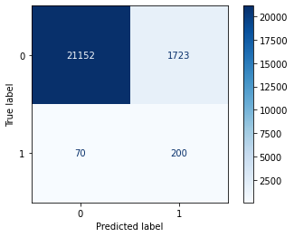
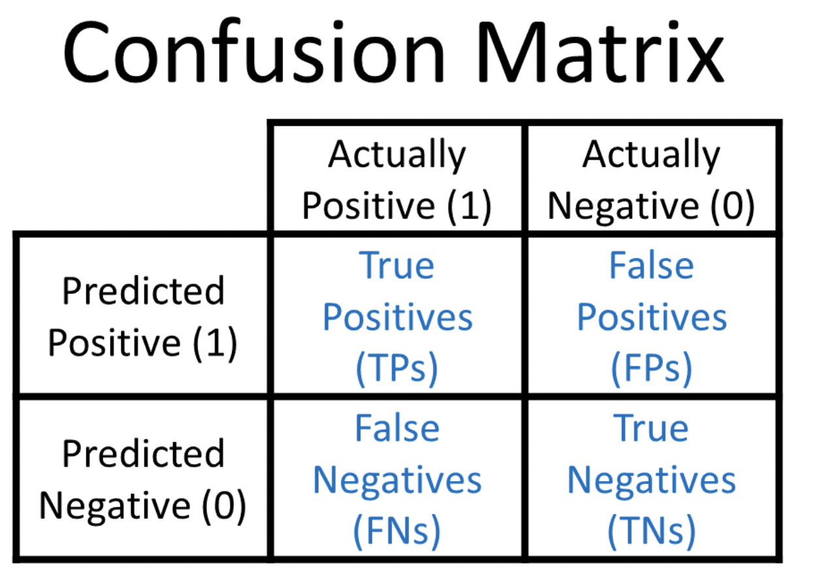
Accuracy Metrics
Confusion Matrix: The confusion matrix illustrates how the algorithm is performing with regard to distinguishing the classes from each other. In a glance, we can see how well our algorithm is doing classifying one class against another
It depends on the problem to interpret what we see in the confusion matrix

Slide 13
When to use which metrics for evaluation?
Accuracy is the standard metric to go for to evaluate a classification machine learning model
But it’s not reliable all the time because it may gives us wrong interpretation
For example in spam detection:
In the case of Email Spam detection, if an email is predicted as a scam but is not actually a scam then it can cause problems to the user.
In this case, we need to focus on reducing the value of FP (i.e when the mail is falsely predicted as spam) and as a result, increasing the value of Precision.
In some cases of imbalanced data problems, both Precision and Recall are important so we consider the F1 score as an evaluation metric.

Slide 14
AUC-ROC Curve
Area Under the Curve (AUC) of Receiver Characteristic Operator
Setting different thresholds for classifying positive class for data points will change the Metrics of the model. And one of these thresholds will probably give a better result than the others, depending on whether we are aiming to lower the number of False Negatives or False Positives
The Receiver Operator Characteristic (ROC) curve is an evaluation metric for binary classification problems. It is a probability curve that plots the TPR against FPR at various threshold values.
The Area Under the Curve (AUC) is the measure of the ability of a classifier to distinguish between classes and is used as a summary of the ROC curve. The higher the AUC, the better the performance of the model at distinguishing between the positive and negative classes.

Slide 15

Next Week
Complete Data Augmentation sheet
Semi-Supervised Models
Cross-Validation
Learn More about AUC-ROC Curve
Cosine/ Jaccard/ Levenshtein Distances

Slide 16
Colab Link

Slide 17
Q & A

Slide 18
Thanks for your attention!

